Slide 1
Finding your new neighborhood
By: Dayna Herling

Slide 2
Introduction/ Business Problem
People move to new cities for work and various reasons, yet they’ll not know the new city at all or very little. As such, it can be very difficult for them to find which neighborhood they would most like to move to.
Can be difficult for a real estate agent to know the preferences of their customer, especially when they are moving from a city the real estate agent is unfamiliar with.

Slide 3

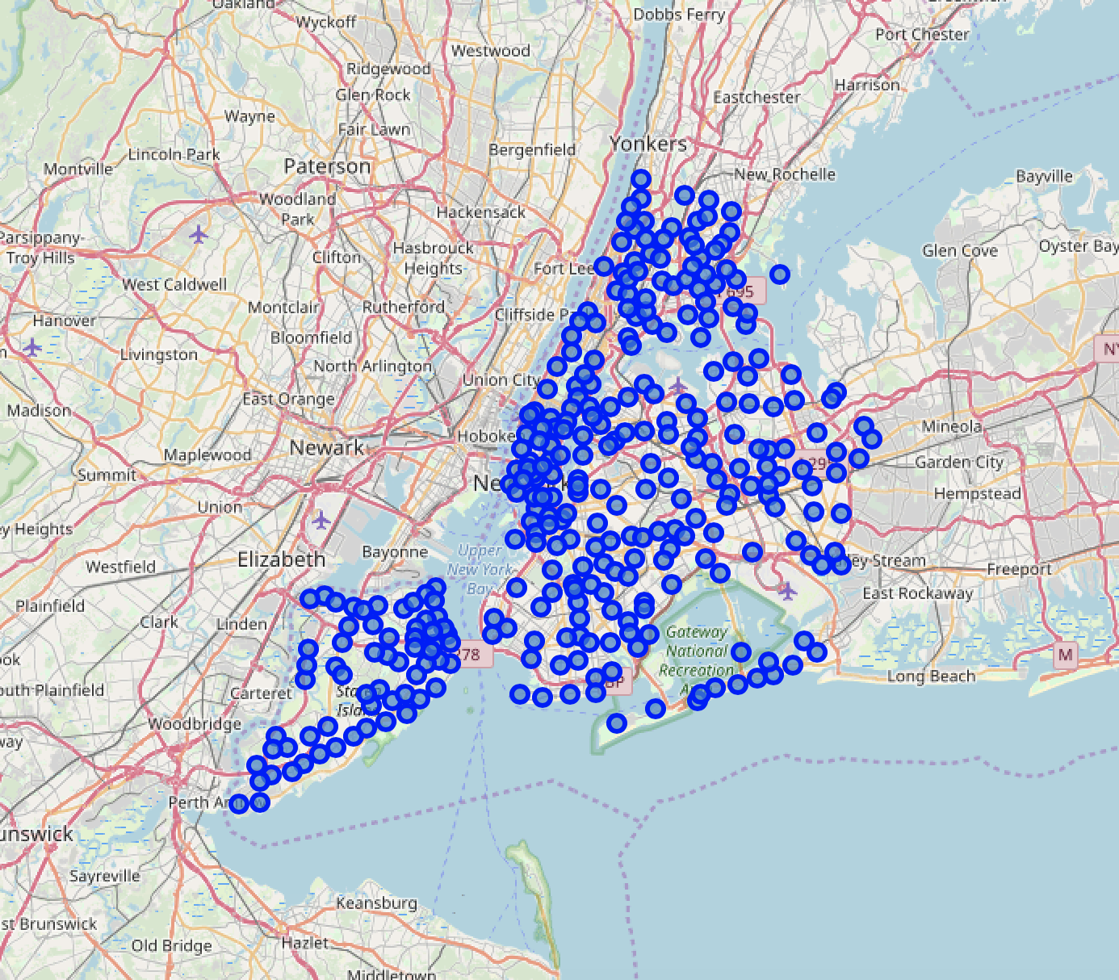
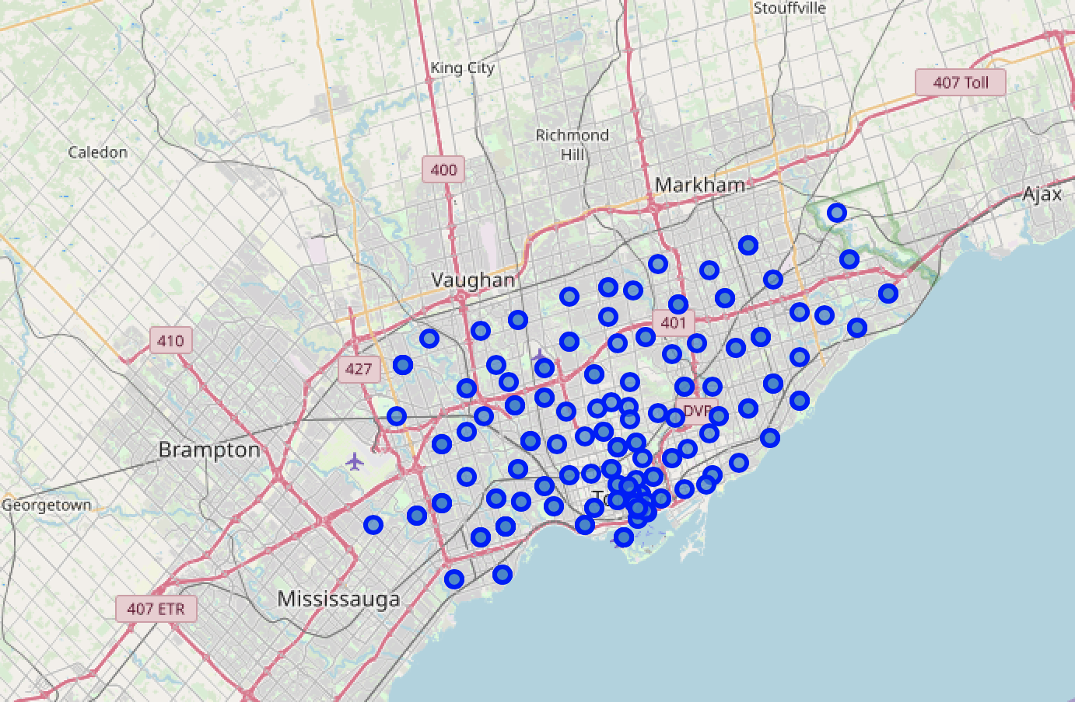
Data

Slide 4
Methodology
1. Bring both New York City and Toronto neighborhood data, with their borough and venues in each into their own DataFrame
2. Make a dictionary of each city with each neighborhood as the key and the values being the top 5 types of venues in each neighborhood
3. Then merge the dictionaries in a way to show the top 5 most similar new neighborhoods (in this case, in NYC) to each old neighborhood (in this case, in Toronto). This is to get the 5 most direct similar neighborhoods to the old neighborhood in question. 4. Cluster the new neighborhoods as to also get similar neighborhoods within the same city to each of the top most similar new neighborhoods found in step 3. This is to get more similar neighborhoods indirectly to the neighborhood in question and to give the person or real estate agents more options, especially if the top 5 most similar neighborhoods are too expensive or dangerous.

Slide 5
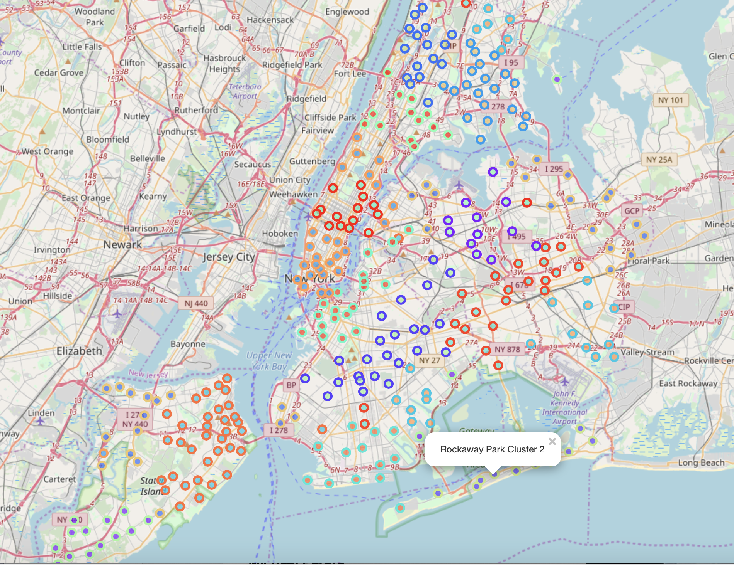
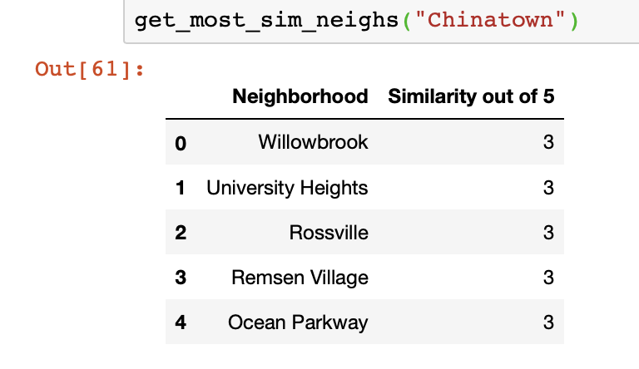
Results
Can replace “Chinatown” with any neighborhood from old city, in this case Toronto

Slide 6
Conclusion
The algorithm successfully finds the most similar neighborhoods from any new city to any ”old” city’s neighborhood.
In this algorithm, I used Toronto as the old city and New York City as the new city, but that was just for example. The algorithm can be easily changed for any two cities by changing the "address" variable in each cell using the geopy library to bring in the longitude and latitude data which is set equal to the cities' names.
The algorithm also successfully shows the neighborhoods that are all in the same cluster for each cluster in the new city. A list also shows which venues are in each of the clusters, so it is very simple to find the most similar neighborhoods, which cluster its in and with which other neighborhoods and what venues are in each.

Slide 7
References
https://media.istockphoto.com/photos/beautiful-luxury-home-exterior-at-twilight-picture-id1026205392?k=6&m=1026205392&s=612x612&w=0&h=pe0Pqbm7GKHl7cmEjf9Drc7Fp-JwJ6aTywsGfm5eQm4=
https://imageog.flaticon.com/icons/png/512/36/36601.png?size=1200x630f&pad=10,10,10,10&ext=png&bg=FFFFFFFF
https://foursquare.com

